Slide 1
Functions & Modules and Data Manipulation in Python
CHINNAM LAKSHMI NARASIMHA KUMAR

Slide 2
A function is a block of code which only runs when it is called. You can pass data, known as parameters, into a function.
Example :
def string_test(s):
d={"UPPER_CASE":0, "LOWER_CASE":0}
for c in s:
if c.isupper():
d["UPPER_CASE"]+=1
elif c.islower():
d["LOWER_CASE"]+=1
else:
pass
Continued in next slide

Slide 3
print ("Original String : ", s)
print ("No. of Upper case characters : ", d["UPPER_CASE"])
print ("No. of Lower case Characters : ", d["LOWER_CASE"])
string_test('Hello Mr. Rogers, how are you this fine Tuesday?’)
Output :
Original String : Hello Mr. Rogers, how are you this fine Tuesday?
No. of Upper case characters : 4
No. of Lower case Characters : 33

Slide 4
Modules :
A Python module is a file containing Python definitions and statements. A module can define functions, classes, and variables.
A module can also include runnable code. Grouping related code into a module makes the code easier to understand and use. It also makes the code logically organized.

Slide 5
Creating a python module :
# A simple module, calc.py
def add(x, y):
return (x+y)
def subtract(x, y):
return (x-y)
Importing module :
# importing module calc.py
import calc
print(calc.add(10, 2))

Slide 6
Data manipulation :
Data Manipulation is the process of manipulating (creating, arranging, deleting) data points in a given data to get insights much easier.
We know that about 90% of the data we have are unstructured.
Data manipulation is a fundamental step in data analysis, data mining, and data preparation for machine learning and is essential for making informed decisions and drawing conclusions from raw data

Slide 7
Operations of Data Manipulation :
Data Manipulation follows the 4 main operations, CRUD (Create, Read, Update and Delete).
It is used in many industries to improve the overall output.
In most DML, there is some version of the CRUD operations where:
Create: To create a new data point or database.
Read: Read the data to understand where we need to perform data manipulation.
Update: Update missing/wrong data points with the correct ones to encourage data to be streamlined.
Delete: Deletes the rows with missing data points/ erroneous/ misclassified data.

Slide 8
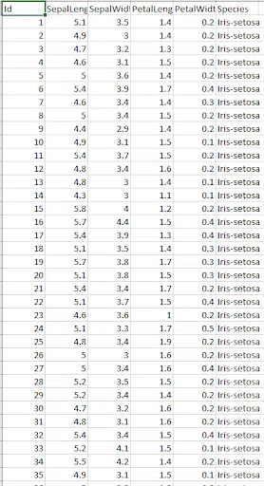
Example of Data Manipulation :
Considering you have a dataset, you’ll need to load it and display it.
The Iris dataset is viewed below:

Slide 9
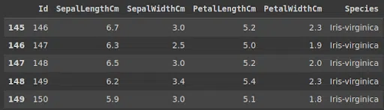
#program for using data manipulation
import pandas as pd
df=pd.read_csv("Iris.csv")
print(df.tail())
Output :

Slide 10

Iam CHINNAM LAKSHMI NARASIMHA KUMAR
Iam available with :
Mail id : lakshminarasimhakumar1234@gmail.com
Github : C-LNKumar · GitHub
Linkedin : www.linkedin.com/in/lakshmi-narasimha-kumar-c-2b66a1294

